Slide 1
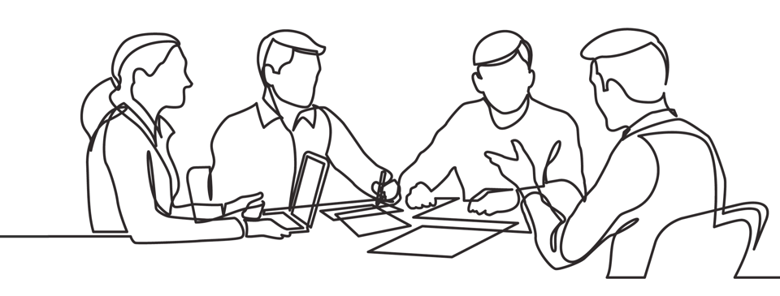

Patrick Lencioni quotes
Brought to you by Discprofile.com
Authorized Partner, The Five Behaviors™

Slide 2
Not finance. Not strategy. Not technology. It is teamwork that remains the ultimate competitive advantage, both because it is so powerful and so rare.
Patrick Lencioni

Slide 3
The kind of people that all teams need are people who are humble, hungry, and smart.
Patrick Lencioni, 3 Indispensable Virtues That Make Teams Successful

Slide 4
Patrick Lencioni on
Trust

Slide 5
Remember teamwork begins by building trust. And the only way to do that is to overcome our need for invulnerability.
Patrick Lencioni, The Five Dysfunctions of a Team

Slide 6
Great teams do not hold back with one another. They are unafraid to air their dirty laundry. They admit their mistakes, their weaknesses, and their concerns without fear of reprisal.
Patrick Lencioni, The Five Dysfunctions of a Team

Slide 7
Vulnerability is often seen as a weakness; it’s actually a sign of strength. People who are genuinely open and transparent prove that they have the confidence and
self-esteem to allow others to see them as they really are, warts and all.
Patrick Lencioni

Slide 8
Trust is knowing that when a team member does push you, they're doing it because they care about the team.
Patrick Lencioni, The Five Dysfunctions of a Team

Slide 9
Vulnerability-based trust is … where they say and genuinely mean things like “I screwed up,” “I need help,” “Your idea is better than mine,” “I wish I could learn to do that as well as you do,” and even, “I'm sorry.”
Patrick Lencioni, The Advantage

Slide 10
The only way for the leader of a team to create a safe environment for his team members to be vulnerable is by stepping up and doing something that feels unsafe and uncomfortable first.
Patrick Lencioni, The Advantage

Slide 11
In order to be the kind of leader who demonstrates genuine interest in employees and who can help people discover the relevance of their work, a person must have a level of personal confidence and emotional vulnerability.
Patrick Lencioni, The Truth About Employee Engagement

Slide 12
Patrick Lencioni on
Conflict

Slide 13
Contrary to popular wisdom and behavior, conflict is not a bad thing for a team. In fact, the fear of conflict is almost always a sign of problems.
Patrick Lencioni, The Advantage

Slide 14
Overcoming the tendency to run from discomfort is one of the most important requirements for any leadership team—in fact, for any leader.
Patrick Lencioni, The Advantage

Slide 15
People will not actively commit to a decision if they have not had the opportunity to provide input, ask questions, and understand the rationale behind it.
Patrick Lencioni, The Advantage

Slide 16
One of the best ways for leaders to raise the level of healthy conflict on a team is by mining for conflict during meetings.
Patrick Lencioni, The Advantage

Slide 17
Great teams avoid the consensus trap by embracing a concept that Intel, the legendary microchip manufacturer, calls "disagree and commit.”
Patrick Lencioni, The Advantage

Slide 18
The more comfortable a leader is holding people on a team accountable, the less likely she is to be asked to do so. The more comfortable a leader is holding people on a team accountable, the less likely she is to be asked to do so.
Patrick Lencioni, The Advantage

Slide 19
Patrick Lencioni on
Commitment

Slide 20
In the context of a team, commitment is a function of two things: clarity and buy-in. Great teams make clear and timely decisions and move forward with complete buy-in from every member of the team, even those who voted against the decision.
Patrick Lencioni, The Five Dysfunctions of a Team: A Leadership Fable

Slide 21
Even cynics understand that groups of people willing to put their individual interests aside for the good of the team will outperform those who do not.
Patrick Lencioni, “A Penalty for Discounting Teamwork”

Slide 22
Members of cohesive teams spend many hours working together on issues and topics that often don't fall directly within their formal areas of responsibility.
Patrick Lencioni, The Advantage

Slide 23
At the end of every meeting, cohesive teams must take a few minutes to ensure that everyone sitting at the table is walking away with the same understanding about what has been agreed to and what they are committed to do.
Patrick Lencioni, The Advantage

Slide 24
It’s worth stating that most of a leadership team’s objectives should be collective ones. If the most important goal within the organization is to increase sales, then every member of the team shares that goal.
Patrick Lencioni, The Advantage

Slide 25
Patrick Lencioni on
Accountability

Slide 26
Even the most ardent believers in accountability usually balk at having to hold someone accountable for something that was never bought in to or made clear in the first place.
Patrick Lencioni, The Five Dysfunctions of a Team

Slide 27
Some people are hard to hold accountable because they are so helpful. Others because they get defensive. Others because they are intimidating. I don’t think it’s easy to hold anyone accountable, not even your own kids.
Patrick Lencioni, The Five Dysfunctions of a Team

Slide 28
At its core, accountability is about having the courage to confront someone about their deficiencies and then to stand in the moment and deal with their reaction, which may not be pleasant.
Patrick Lencioni, The Advantage

Slide 29
To hold someone accountable is to care about them enough to risk having them blame you for pointing out their deficiencies.
Patrick Lencioni, The Advantage

Slide 30
Peer-to-peer accountability is the primary and most effective source of accountability on the leadership team of a healthy organization.
Patrick Lencioni, The Advantage

Slide 31
More than any policy or system, there is nothing like the fear of letting down respected teammates that motivate people to improve their performance.
Patrick Lencioni, The Five Dysfunctions of a Team

Slide 32
Make sure that you have a very strong team at the top. Make sure that the people at the top are working together and there aren’t divisions of labor. Don’t have people working in silos, have them working across the team.
Patrick Lencioni, 3 Indispensable Virtues That Make Teams Successful

Slide 33
Patrick Lencioni on
Results

Slide 34
A functional team must make the collective results of the group more important to each individual than individual members’ goals.
Patrick Lencioni, The Five Dysfunctions of a Team

Slide 35
A team ensures that its attention is focused on results by making results clear, and rewarding only those behaviors and actions that contribute to those results.
Patrick Lencioni, The Five Dysfunctions of a Team

Slide 36
The ultimate point of building greater trust, conflict, commitment, and accountability is one thing: the achievement of results.
Patrick Lencioni, The Advantage

Slide 37
When it comes to how a cohesive team measures its performance, one criterion sets it apart from non-cohesive ones: its goals are shared across the entire team.
Patrick Lencioni, The Advantage

Slide 38
Patrick Lencioni on
Culture

Slide 39
Great cultures tend to be appropriately intolerant of certain behaviors, and great teams should be quick and tactful in addressing any lack of humility, hunger, and people smarts.
Patrick Lencioni, The Ideal Team Player

Slide 40
Politics is when people choose their words and actions based on how they want others to react rather than based on what they really think.
Patrick Lencioni, The Five Dysfunctions of a Team

Slide 41
Great team leaders won’t be afraid to call out a simple act of teamwork when they see it. … They want everyone to know exactly what kinds of behavior they expect and appreciate.
Patrick Lencioni, The Ideal Team Player

Slide 42
All too often, employees struggle to become hungry because they don’t understand the connection between what they do and the impact it has on others, be they customers, vendors, or other employees.
Patrick Lencioni, The Ideal Team Player

Slide 43
The reason why nasty terminations and even lawsuits happen in so many organizations is that managers stop reminding people that they aren’t living up to expectations.
Patrick Lencioni, The Ideal Team Player

Slide 44
The point here is that every organization, if it wants to create a sense of alignment and focus, must have a single top priority within a given period of time.
Patrick Lencioni, The Advantage

Slide 45
What's the practical lesson for companies trying to improve? They should start by spending more of their time and effort creating a culture of teamwork than looking for outside talent.
Patrick Lencioni, “A Penalty for Discounting Teamwork”

Slide 46
The truth is, there is no more valuable activity in any organization than the regular staff meeting of a leadership team. But if they are not effective, there is little or no chance of building a cohesive team or a healthy organization.
Patrick Lencioni, The Advantage

Slide 47
An organization has integrity—is healthy—when it is whole, consistent, and complete, that is, when its management, operations, strategy, and culture fit together and make sense.
Patrick Lencioni, The Advantage

Slide 48
An organization that is healthy will inevitably get smarter over time. That's because people in a healthy organization, beginning with the leaders, learn from one another, identify critical issues, and recover quickly from mistakes.
Patrick Lencioni, The Advantage

Slide 49
These are the six questions:
Why do we exist?
How do we behave?
What do we do?
How will we succeed?
What is most important, right now?
Who must do what?
Patrick Lencioni, The Advantage

Slide 50
Employees in every organization, and at every level, need to know that at the heart of what they do lies something grand and aspirational.
Patrick Lencioni, The Advantage

Slide 51
The truth is, being the leader of a healthy organization is just plain hard. But in the end, it is undeniably worth it.
Patrick Lencioni, The Advantage

Slide 52
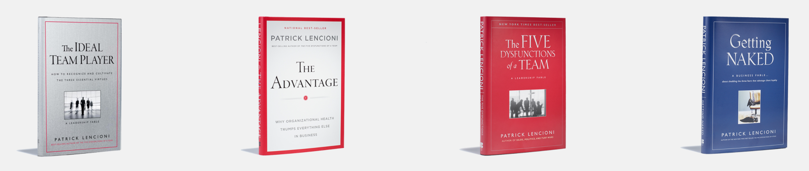
Patrick Lencioni
Patrick is one of the founders of The Table Group and is the pioneer of the organizational health movement. He is the author of 11 books, which have sold over 6 million copies and been translated into more than 30 languages.

Slide 53
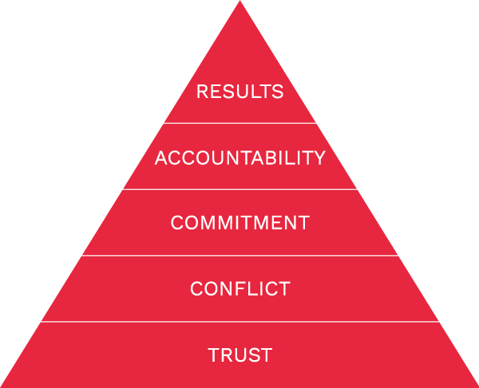
The Five Behaviors®
A partnership between Wiley Professional Learning and best-selling author Patrick Lencioni, The Five Behaviors® can revolutionize how your teams work together to accomplish collective goals.
By teaching and actively applying The Five Behaviors—Trust, Conflict, Commitment, Accountability, and Results—these dynamic team development solutions empower team members to rethink their approach to teamwork.
Learn more at Discprofile.com

