Slide 1
Execution
Activities for Everything DiSC® Work of Leaders

Slide 2
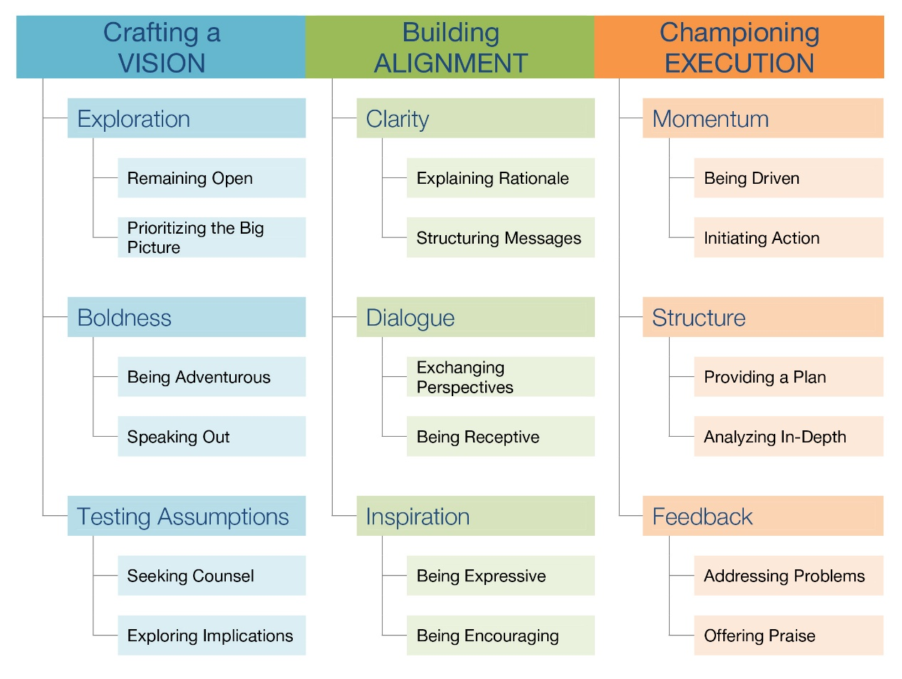
Work of Leaders model
Vision
Alignment
Execution
Everything DiSC Work of Leaders

Slide 3
Vision without execution is hallucination.
Thomas Edison

Slide 4
Leadership is the capacity to translate vision into reality.
Warren G. Bennis

Slide 5
Championing execution
“Championing execution is as much about establishing and defining your credibility as an effective leader as it is about helping the organization or team achieve the vision.”

Slide 6
What environment do you create?
Do you…
encourage a sense of positive challenge?
encourage collaboration?
encourage the exploration of new ideas?
give appropriate recognition?
introduce and sustain ways of sharing ideas across your organization?

Slide 7
Leadership commitment
“Support and advocacy from a leader confirms the vision is not just talk, not just aspiration, and is something that can really be done, something that is within reach.”

Slide 8
When has someone acted in one of these roles for you?
Defender (of an idea or your team, for example)
Proponent (of your plan or proposed change)
Advocate (for your work, expertise, budget)
Lobbyist (for resources, support)
Booster (to provide support, momentum)
When have you acted in these roles for others?

Slide 9
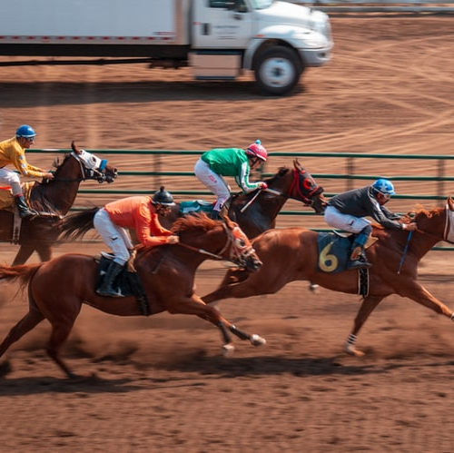
Championing execution through momentum

Slide 10
Do you need help driving results?
Low-key
Driven
Reactive
Initiating
For the purpose of execution, you’ll be more successful moving toward the behavior on the right.

Slide 11
Discuss
Are there projects you’re in charge of that are in danger of stalling out?
How do you communicate your expectations?
How can you motivate others to pick up the pace and focus on results?

Slide 12
A leader can help teams follow through on resolutions by having members create clear maps for reaching their goals that detail the ‘when’ and the ‘how.’
Ask ‘What could I do?’ instead of ‘What should I do?’ to recognize alternatives.
John Beshears and Francesca Gino, Leaders as Decision Architects, Harvard Business Review

Slide 13
Meetings
Do each of your meetings move your project forward?
How do you measure progress?
Does your team commit to deadlines?
Does your team hold each other accountable for their responsibilities?
See Five Tips for Better Meetings (pdf) and Patrick Lencioni - Meetings (video)

Slide 14
Decide how to decide
What needs to be decided?
Who gathers data, who drafts a recommendation, and who provides input?
How will we give weight to data and input?
When do we need the decision made?
Who has to sign off on the decision?
Who has the final accountability?

Slide 15
Try this
Set aside a “check-in” time for yourself each day, and for your team, each month.
Ask yourself / your team:
What’s the most important thing my team (or department or staff) can do today to meet our goal(s)?
How can I go above and beyond today?

Slide 16
Championing execution through structure

Slide 17
Do you need help with structure?
Improvise
Plan
Follow first impressions
Analyze in depth
For the purpose of execution, you’ll be more successful moving toward the behavior on the right.
What processes, policies, and expectations have you put in place?
Do you take time to plan and analyze?

Slide 18
Failure to plan is
planning to fail.
Proverbial wisdom

Slide 19
Your role in planning
Involve your team.
Stay plugged into the planning process.
Provide resources and time for planning.
Match the complexity to the need. Keep the plan focused.

Slide 20
Too often, leaders get sucked into day-to-day operations and lose sight of the execution of strategy. And if they don’t provide focus and consistent oversight of progress, line managers and individual contributors fall back into their normal routines.
Gregory Billhardt, sales and marketing strategist

Slide 21
Championing execution through feedback

Slide 22
Feedback
Q: What’s the top thing leaders most often fail to do when working with others?
A: Provide appropriate feedback.
Survey by The Ken Blanchard Companies of 1,400 leaders, managers, and executives.

Slide 23
Feedback takes effort
“The [feedback] process strikes at the tension between two core human needs — the need to learn and grow, and the need to be accepted just the way you are.”
Sheila Heen and Douglas Stone, Find the Coaching in Criticism

Slide 24
Championing execution through feedback
Two aspects of feedback
Addressing problems
Offering praise

Slide 25
Create a culture of candor
What’s the culture of your team and workplace?
Can people speak up about problems, admit confusion?
Is conflict welcomed?
Are things only artificially harmonious?

Slide 26
What keeps us quiet?
Political factors.
It’s not in my nature.
I don’t want to stir up tension.
I don’t want to discourage people.
I don’t want to hurt people’s feelings.
It won’t actually improve things around here.
I’d have to spend more time fixing problems.

Slide 27
Feedback drives execution
Maintain harmony
Address problems
For the purpose of execution, you’ll be more successful moving toward the behavior on the right.

Slide 28
Consider
How do you hold people accountable?
Is your team culture one of “terminal politeness?”
How do you deliver feedback?
How do your staff or team members want to receive feedback?
Do you look for problems?
Does the messenger get punished or rewarded?

Slide 29
Addressing problems
Timely: When do you seek out problems? (The higher you go, the further away you get.)
Specific: Where do you look for problems?
Regular: How are problem-surfacing and problem-solving events scheduled and run?
Follow up: Who follows up on issues, how are steps reported back, and to whom?

Slide 30
Try a personal note
Acknowledge the issue.
Give encouragement.
Instead of placing blame, express confidence in one’s ability to implement a solution.

Slide 31
Genuine praise
Do you feel heartfelt gratitude or appreciation?
Do you know enough about your staff’s work to be able to give specific praise?
Do you tend to acknowledge some people more than others?
Do you know how each of your staff prefers to receive positive feedback? (Their DiSC style might provide a clue.)

Slide 32
Offering praise
Practice it now.
Select someone and write a note of praise.
Be specific. How does this person make a difference in the organization, in your life, in the life of your customers?
Make it heartfelt.
A “good job” or gold star is not enough.

Slide 33
Feedback drives execution
Offer less praise
Offer more praise
For the purpose of execution, you’ll be more successful moving toward the behavior on the right.

Slide 34
Action without vision is only passing time, vision without action is merely day dreaming, but vision with action can change the world.
Nelson Mandela

Slide 35
Would your followers agree?
My leader…
sets high expectations.
focuses on improving our methods.
rallies people to achieve goals.
encourages us to stretch our boundaries.
is open to input from others.

Slide 36
Image of a leader
“Traditional images of leadership didn’t assign much value to relating. Flawless leaders shouldn’t need to seek counsel from anyone outside their tight inner circle, … and they were expected to issue edicts rather than connect on an emotional level. Times have changed, of course, and in this era of networks, being able to build trusting relationships is a requirement of effective leadership.”
In Praise of the Incomplete Leader, Harvard Business Review

Slide 37
What’s your image?
What’s your image of a leader?
Have these exercises changed your self-image as a leader?
Where do you need to grow as a leader?

Slide 38
Learn more at discprofile.com
Everything DiSC Work of Leaders Facilitation Kit
Activities for Work of Leaders trainings
Work of Leaders supplemental readings
The book: The Work of Leaders: How Vision, Alignment, and Execution Will Change the Way You Lead
The Everything DiSC Work of Leaders assessment

Slide 39
Links to quoted articles
Leaders as Decision Architects
Five Tips for Better Meetings
Patrick Lencioni – Meetings
Find the Coaching in Criticism
In Praise of the Incomplete Leader

