Slide 1
Leadership quotes
Brought to you by Discprofile.com

Slide 2
Leadership is a series of behaviors rather than a role for heroes.
― Margaret Wheatley, writer and management consultant

Slide 3
People buy into the leader before they buy into the vision.
― John Maxwell

Slide 4
It’s up to us to be transparent, to do the right thing, to believe in what we do, to gain trust.
Pablo Isla, Inditex CEO

Slide 5
They bring you the harder decisions. It’s very helpful to have a really strong sense of what’s right and wrong for the company, not for you. That’s an important distinction.
Kenneth Frazier, CEO, Merck

Slide 6
A leader isn’t someone who forces others to make him stronger; a leader is someone willing to give his strength to others that they may have the strength to stand on their own.
Beth Revis, author

Slide 7
All leaders have both an agenda they’re driving and an agenda that’s driving them. The agenda you’re driving is the business part of it. The agenda that’s driving you is the psychology part.
Robert Kegan, “When to change how you lead,” McKinsey Quarterly

Slide 8
If your actions inspire others to dream more, learn more, do more and become more, you are a leader.
John Quincy Adams

Slide 9
Create a compelling vision, one that takes people to a new place, and then translate that vision into a reality.
Warren Bennis

Slide 10
Leadership is having a vision, sharing that vision, and inspiring others to support your vision while creating their own.
Mindy Gibbins-Klein, founder, REAL Thought Leaders

Slide 11
Great leaders make an explicit connection between what they are trying to achieve in the marketplace and what they are building in the workplace.
Bill Taylor, cofounder of Fast Company

Slide 12
I could best influence our organization by communicating and shaping its goals and vision.
Julia Hertz, co-founder and president of Eventbrite

Slide 13
A leader needs a message that can be identified, understood, and incorporated by the constituency you’re trying to lead. So you just have to keep saying the same things over and over.
Drew Gilpin Faust, President Emeritus, Harvard University

Slide 14
Motivating people and generating a sense of spirit inside a company are essential parts of the CEO’s role. We need to appeal to our employees’ emotions to help create an environment where they can innovate.
Pablo Isla, Inditex CEO

Slide 15
A real leader is somebody who can help us overcome the limitations of our own individual laziness and selfishness and weakness and fear and get us to do better, harder things than we can get ourselves to do on our own.
David Foster Wallace

Slide 16
To handle yourself, use your head; to handle others, use your heart.
Eleanor Roosevelt

Slide 17
Value teamwork more than—or equal to—individual accomplishments. After all, your company’s success depends on everyone working together well.
Joan C. Williams, Marina Multhaup, and Sky Mihaylo, “Why Companies Should Add Class to Their Diversity Discussions,” Harvard Business Review

Slide 18
When you’re a leader, you work for your employees. Not the other way around.
Gary Vaynerchuk, chairman of VaynerX

Slide 19
Clients do not come first. Employees come first. If you take care of your employees, they will take care of the clients.
Richard Branson, founder of Virgin Group

Slide 20
Leadership is the ability to guide others without force into a direction or decision that leaves them still feeling empowered and accomplished.
Lisa Cash Hanson, CEO, Snuggwugg

Slide 21
As a leader, it’s up to you to adapt to the people you have the privilege of leading.
Mike Krzyzewski, coach

Slide 22
A company is people. Employees want to know… am I being listened to or am I a cog in the wheel? People really need to feel wanted.
Richard Branson, founder of Virgin Group

Slide 23
True leaders understand that leadership is not about them about about those they serve. It is not about exalting themselves but about lifting others up.
Sheri L. Dew, CEO, Deseret Book Company

Slide 24
The most important thing about a commander is his effect on morale.
Field Marshal Viscount Slim

Slide 25
If you can’t swallow your pride, you can’t lead. Even the highest mountain had animals that step on it.
Jack Weatherford, in Genghis Khan and the Making of the Modern World

Slide 26
In the years I’ve been thinking and talking about leadership, I’ve come to realize that the desperate need for accountable leaders is the fundamental challenge organizations are facing today.
Vince Molinaro, in The Leadership Contract

Slide 27
When things go wrong in your command, start searching for the reason in increasingly large circles around your own desk.
Gen. Bruce Clarke

Slide 28
True leadership stems from individuality that is honestly and sometimes imperfectly expressed…. Leaders should strive for authenticity over perfection.
Sheryl Sandberg, COO Facebook

Slide 29
In the face of leadership flaws, too many people assume cynical perspectives, rather than do the hard work of building relationships in which they can have more positive influence.
Ira Chaleff

Slide 30
Nearly all men can stand adversity, but if you want to test a man’s character, give him power.
Abraham Lincoln

Slide 31
By establishing milestones, gates, and questions along the way, you’re ensuring that you’re being smart about the risks you’re taking. And as hard as it is, you’ve got to be ready to say, “We are stopping.”
Ina Kamenz, former CIO of Eli Lilly and Company

Slide 32
Leadership is about transforming an institution, and if you want to have a sustainable transformation, you need to develop leaders who will continue the journey after you.
Bernard Fontana, CEO of Holcim

Slide 33
Leaders aren’t born, they are made. And they are made just like anything else, through hard work. And that’s the price we’ll have to pay to achieve that goal, or any goal.
Vince Lombardi, American football player and coach

Slide 34
Leadership is being bold enough to have vision and humble enough to recognize achieving it will take the efforts of many.
Kathy Heasley, founder and president, Heasley & Partners

Slide 35
The goal with new power is not to hoard it but to channel it.
Jeremy Heimans and Henry Timms, “Understanding ‘New Power,’” Harvard Business Review

Slide 36
One thing I’ve come to understand is how important listening is to leadership.
Drew Gilpin Faust, President Emeritus, Harvard University

Slide 37
Leadership should be born out of the understanding of the needs of those who would be affected by it.
Marian Anderson, American contralto

Slide 38
Leadership is the sum total of who you are. Leaders are developed, not simply born, and we can all develop ourselves to be able to guide others. Anyone who follows their internal compass can become an authentic leader.
Bill George, former Medtronic chairman and CEO

Slide 39
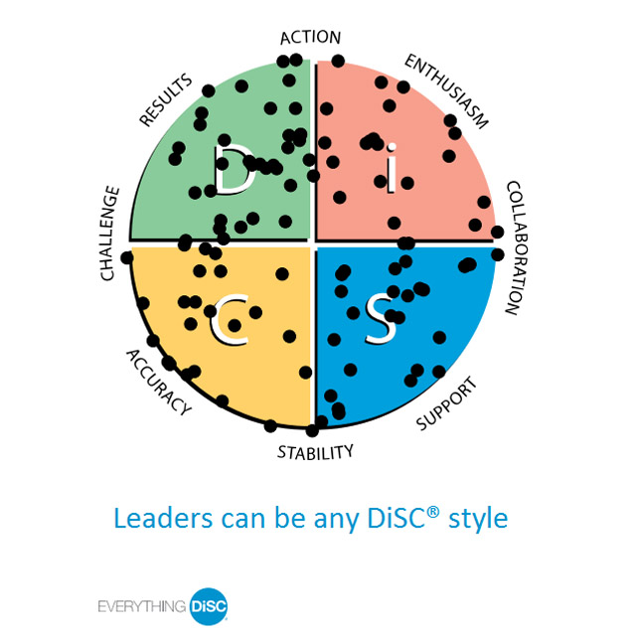
Learn more at discprofile.com

Slide 40
Links to quoted articles
When to change how you lead
Why Companies Should Add Class to Their Diversity Discussions
Understanding “New Power”

